Slide 1
Active Cardiovascular System (ACS)
Antonio Melendez
Larissa Tarango

Slide 2
innovative Design
Larissa Tarango:
Revised Circuit Design and Hardware Implementation
Antonio Melendez:
Programming and Initial Circuit Design

Slide 3
Problem
Strokes are the leading cause of death
130,000 Americans per year
Approximately 1.5 million in Texas living with Cardiovascular Disease
El Paso
Total Population: 676,160
78.6% Hispanics

Slide 4
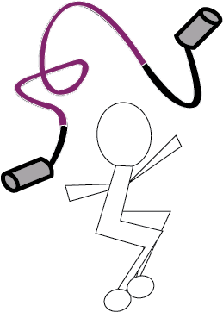
Concept
BPM App
ECG
MCU
RGB
Fiber
Rope
LiPo

Slide 5
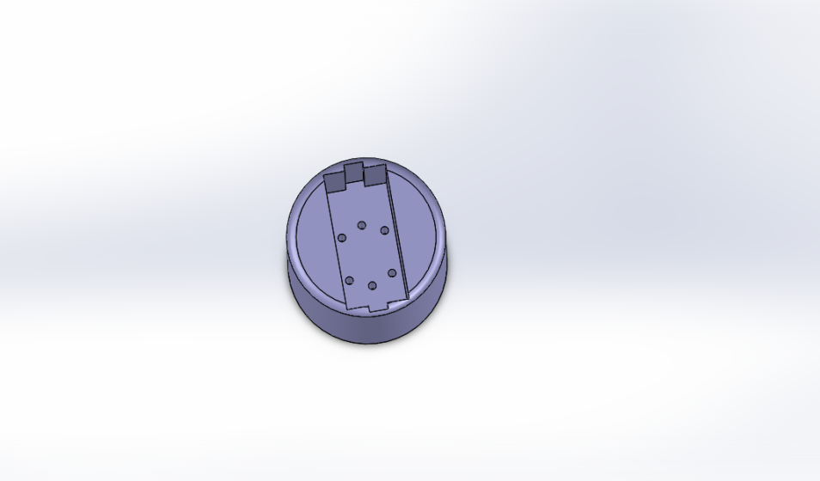
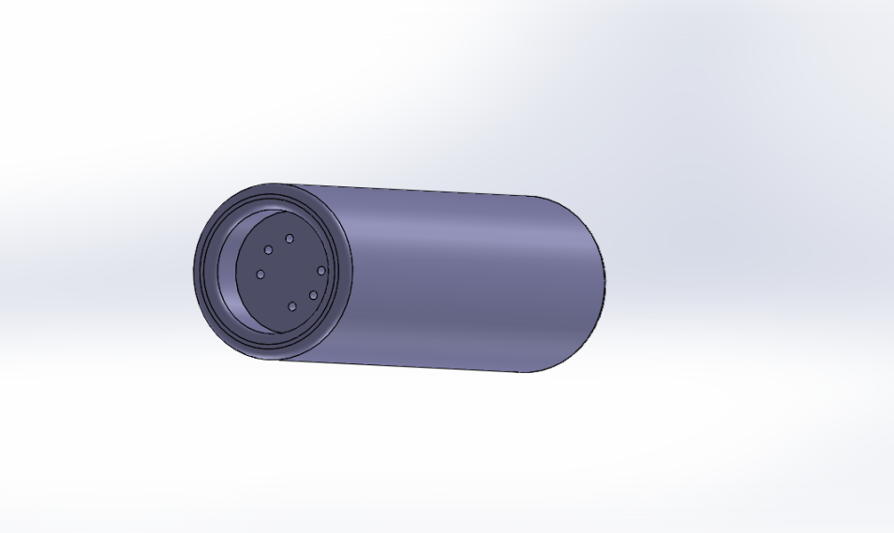
Initial Handle
ECG and Handle
3D Printed
Ergonomic

Slide 6
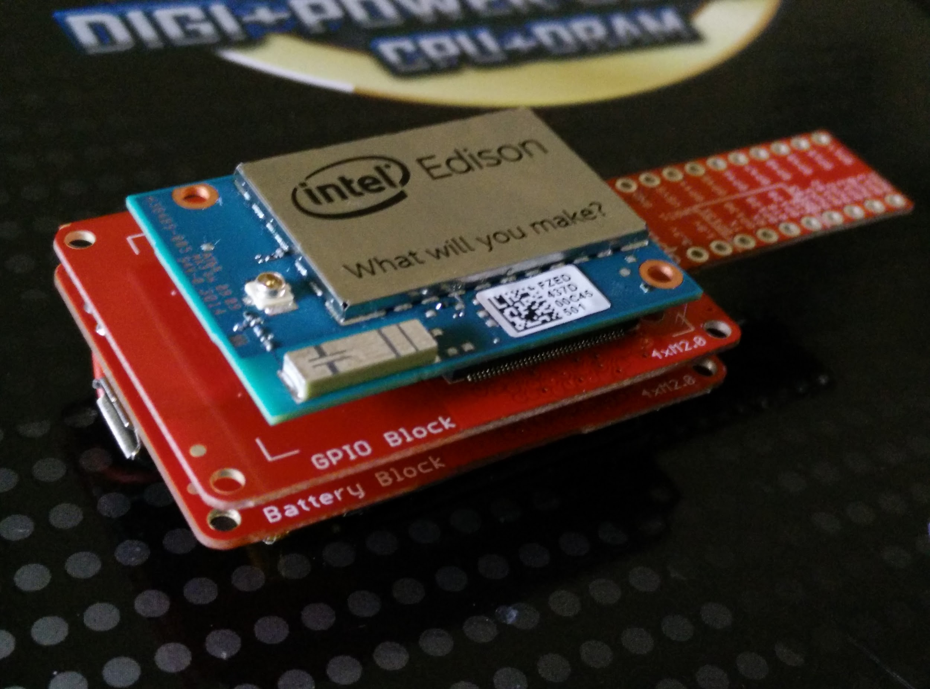
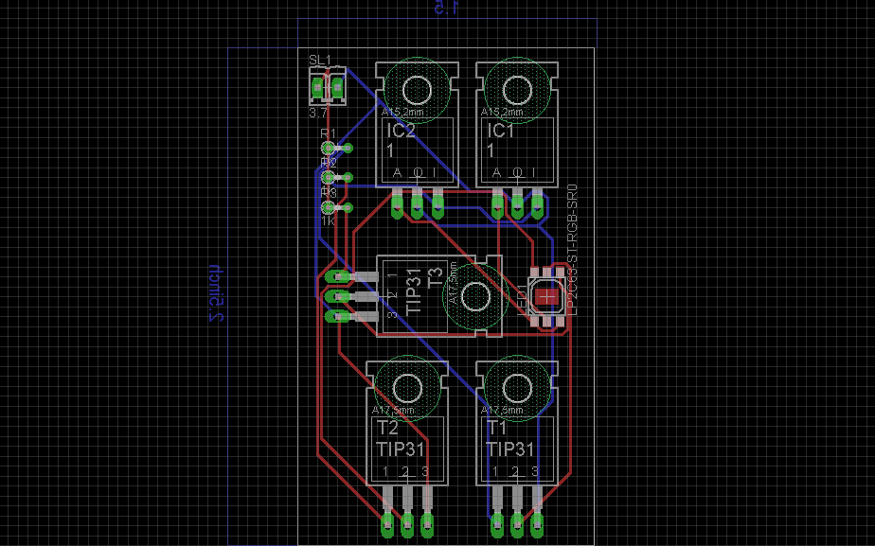
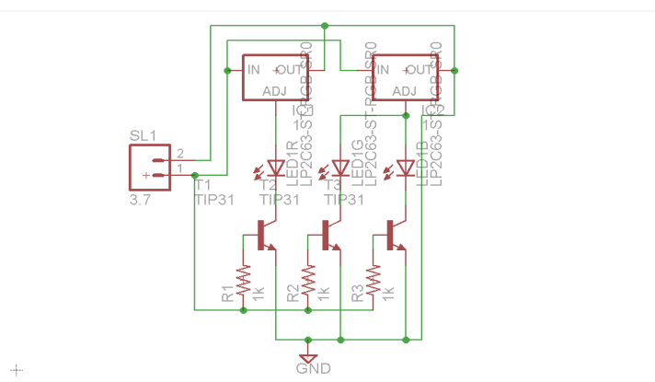
PCB
GPIO Block
Lithium-Po Battery
LED

Slide 7
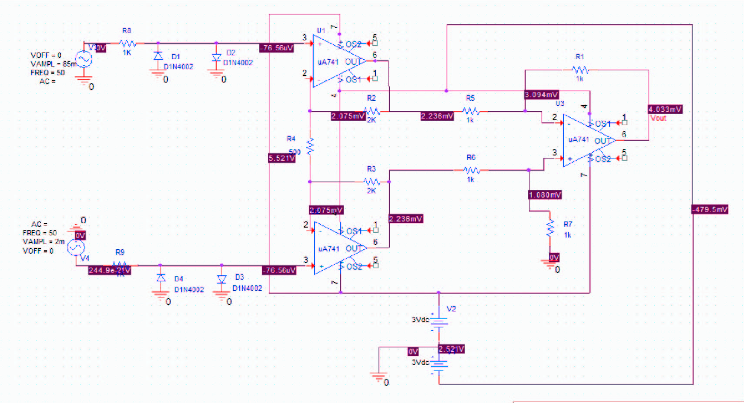
ECG

Slide 8
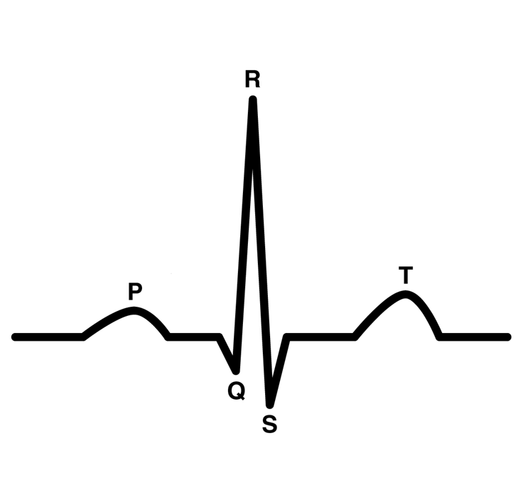
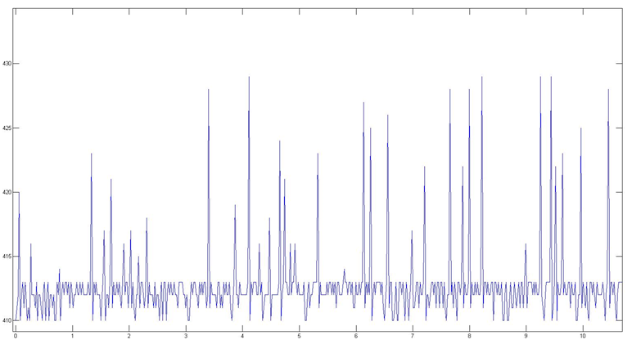
ECG

Slide 9

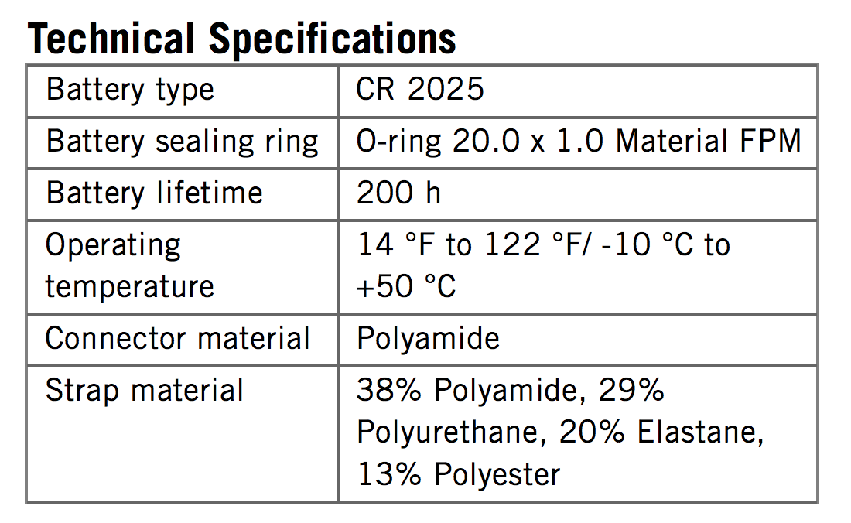
Chest Band

Slide 10

Intel Edison
Linux
Bluetooth Low Energy
Wi-Fi direct

Slide 11

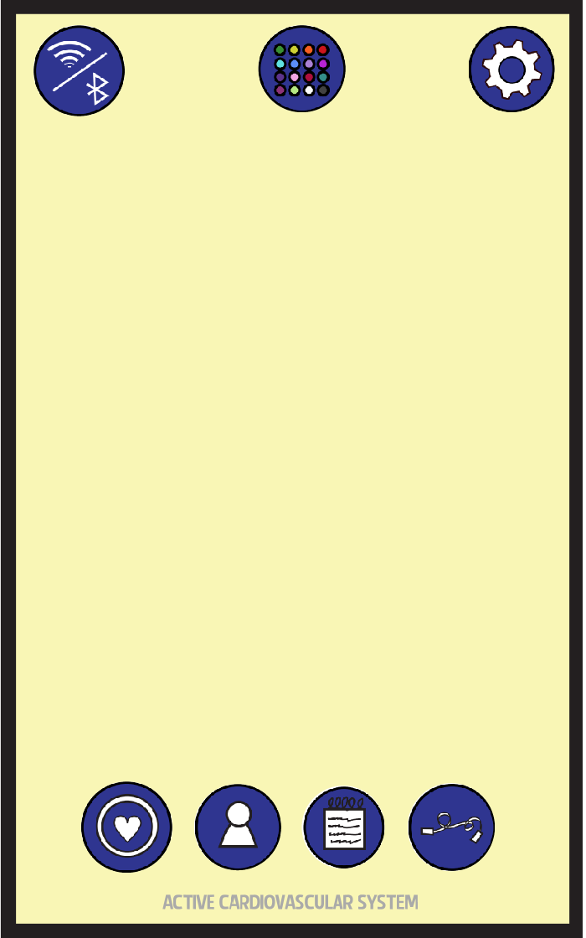
Android App
Android
Java
Wi-Fi

Slide 12
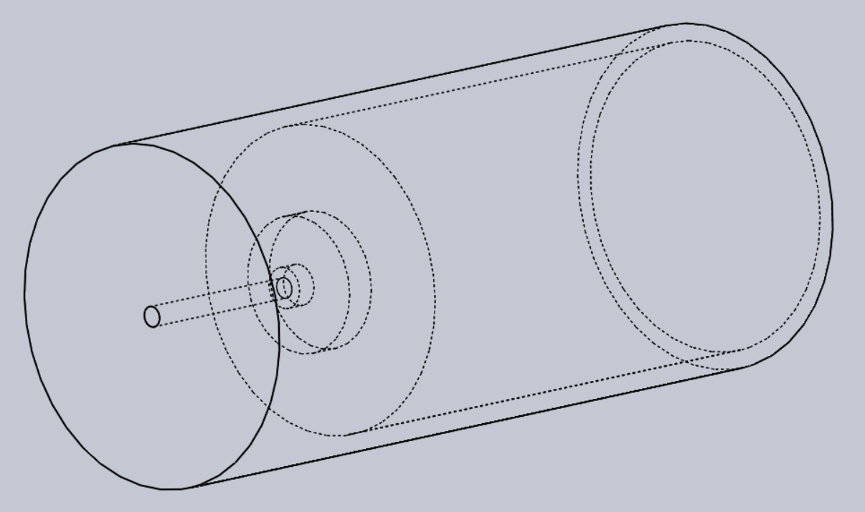
Handle

Slide 13
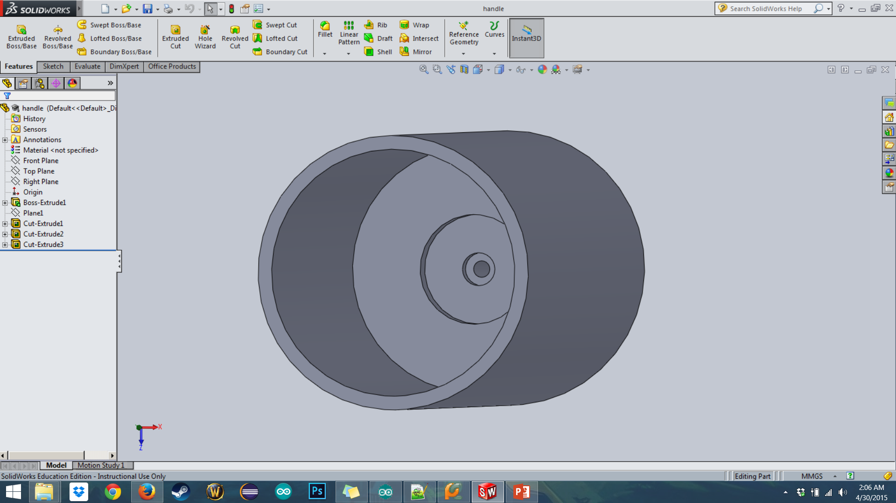
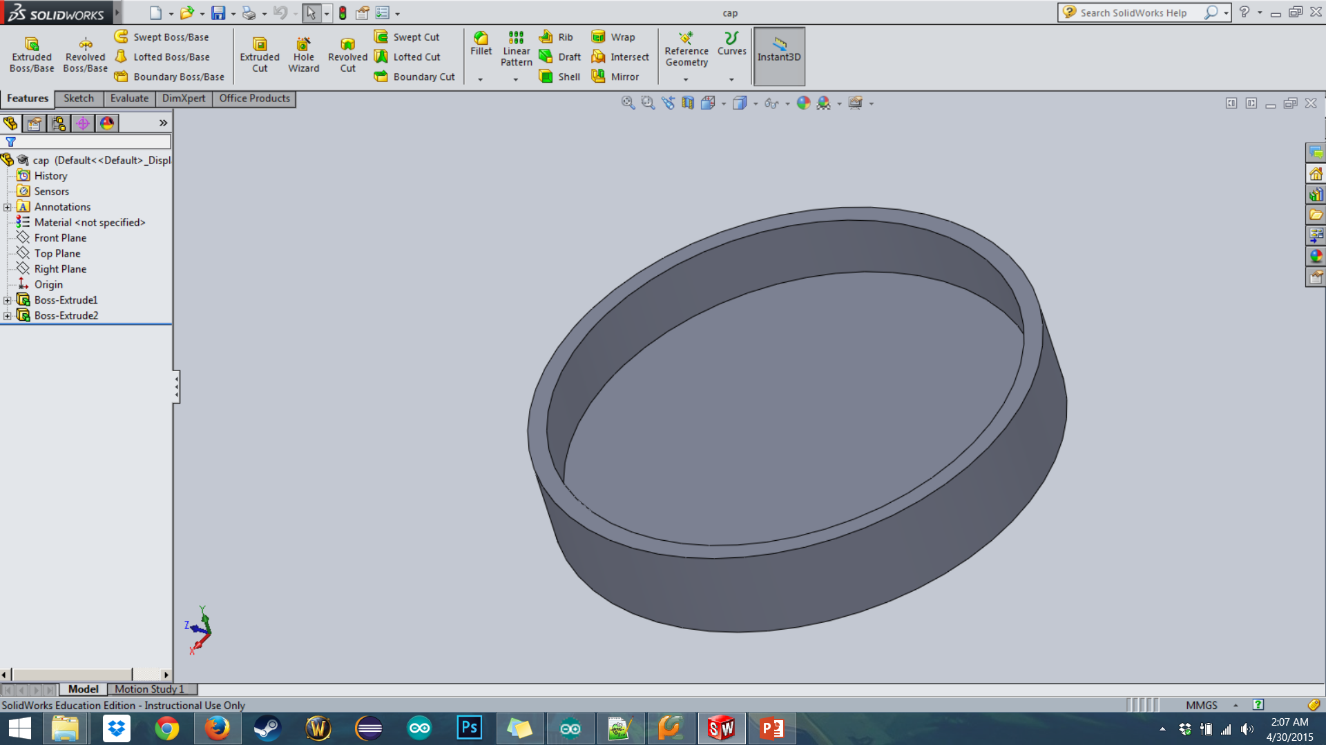
Handle

Slide 14
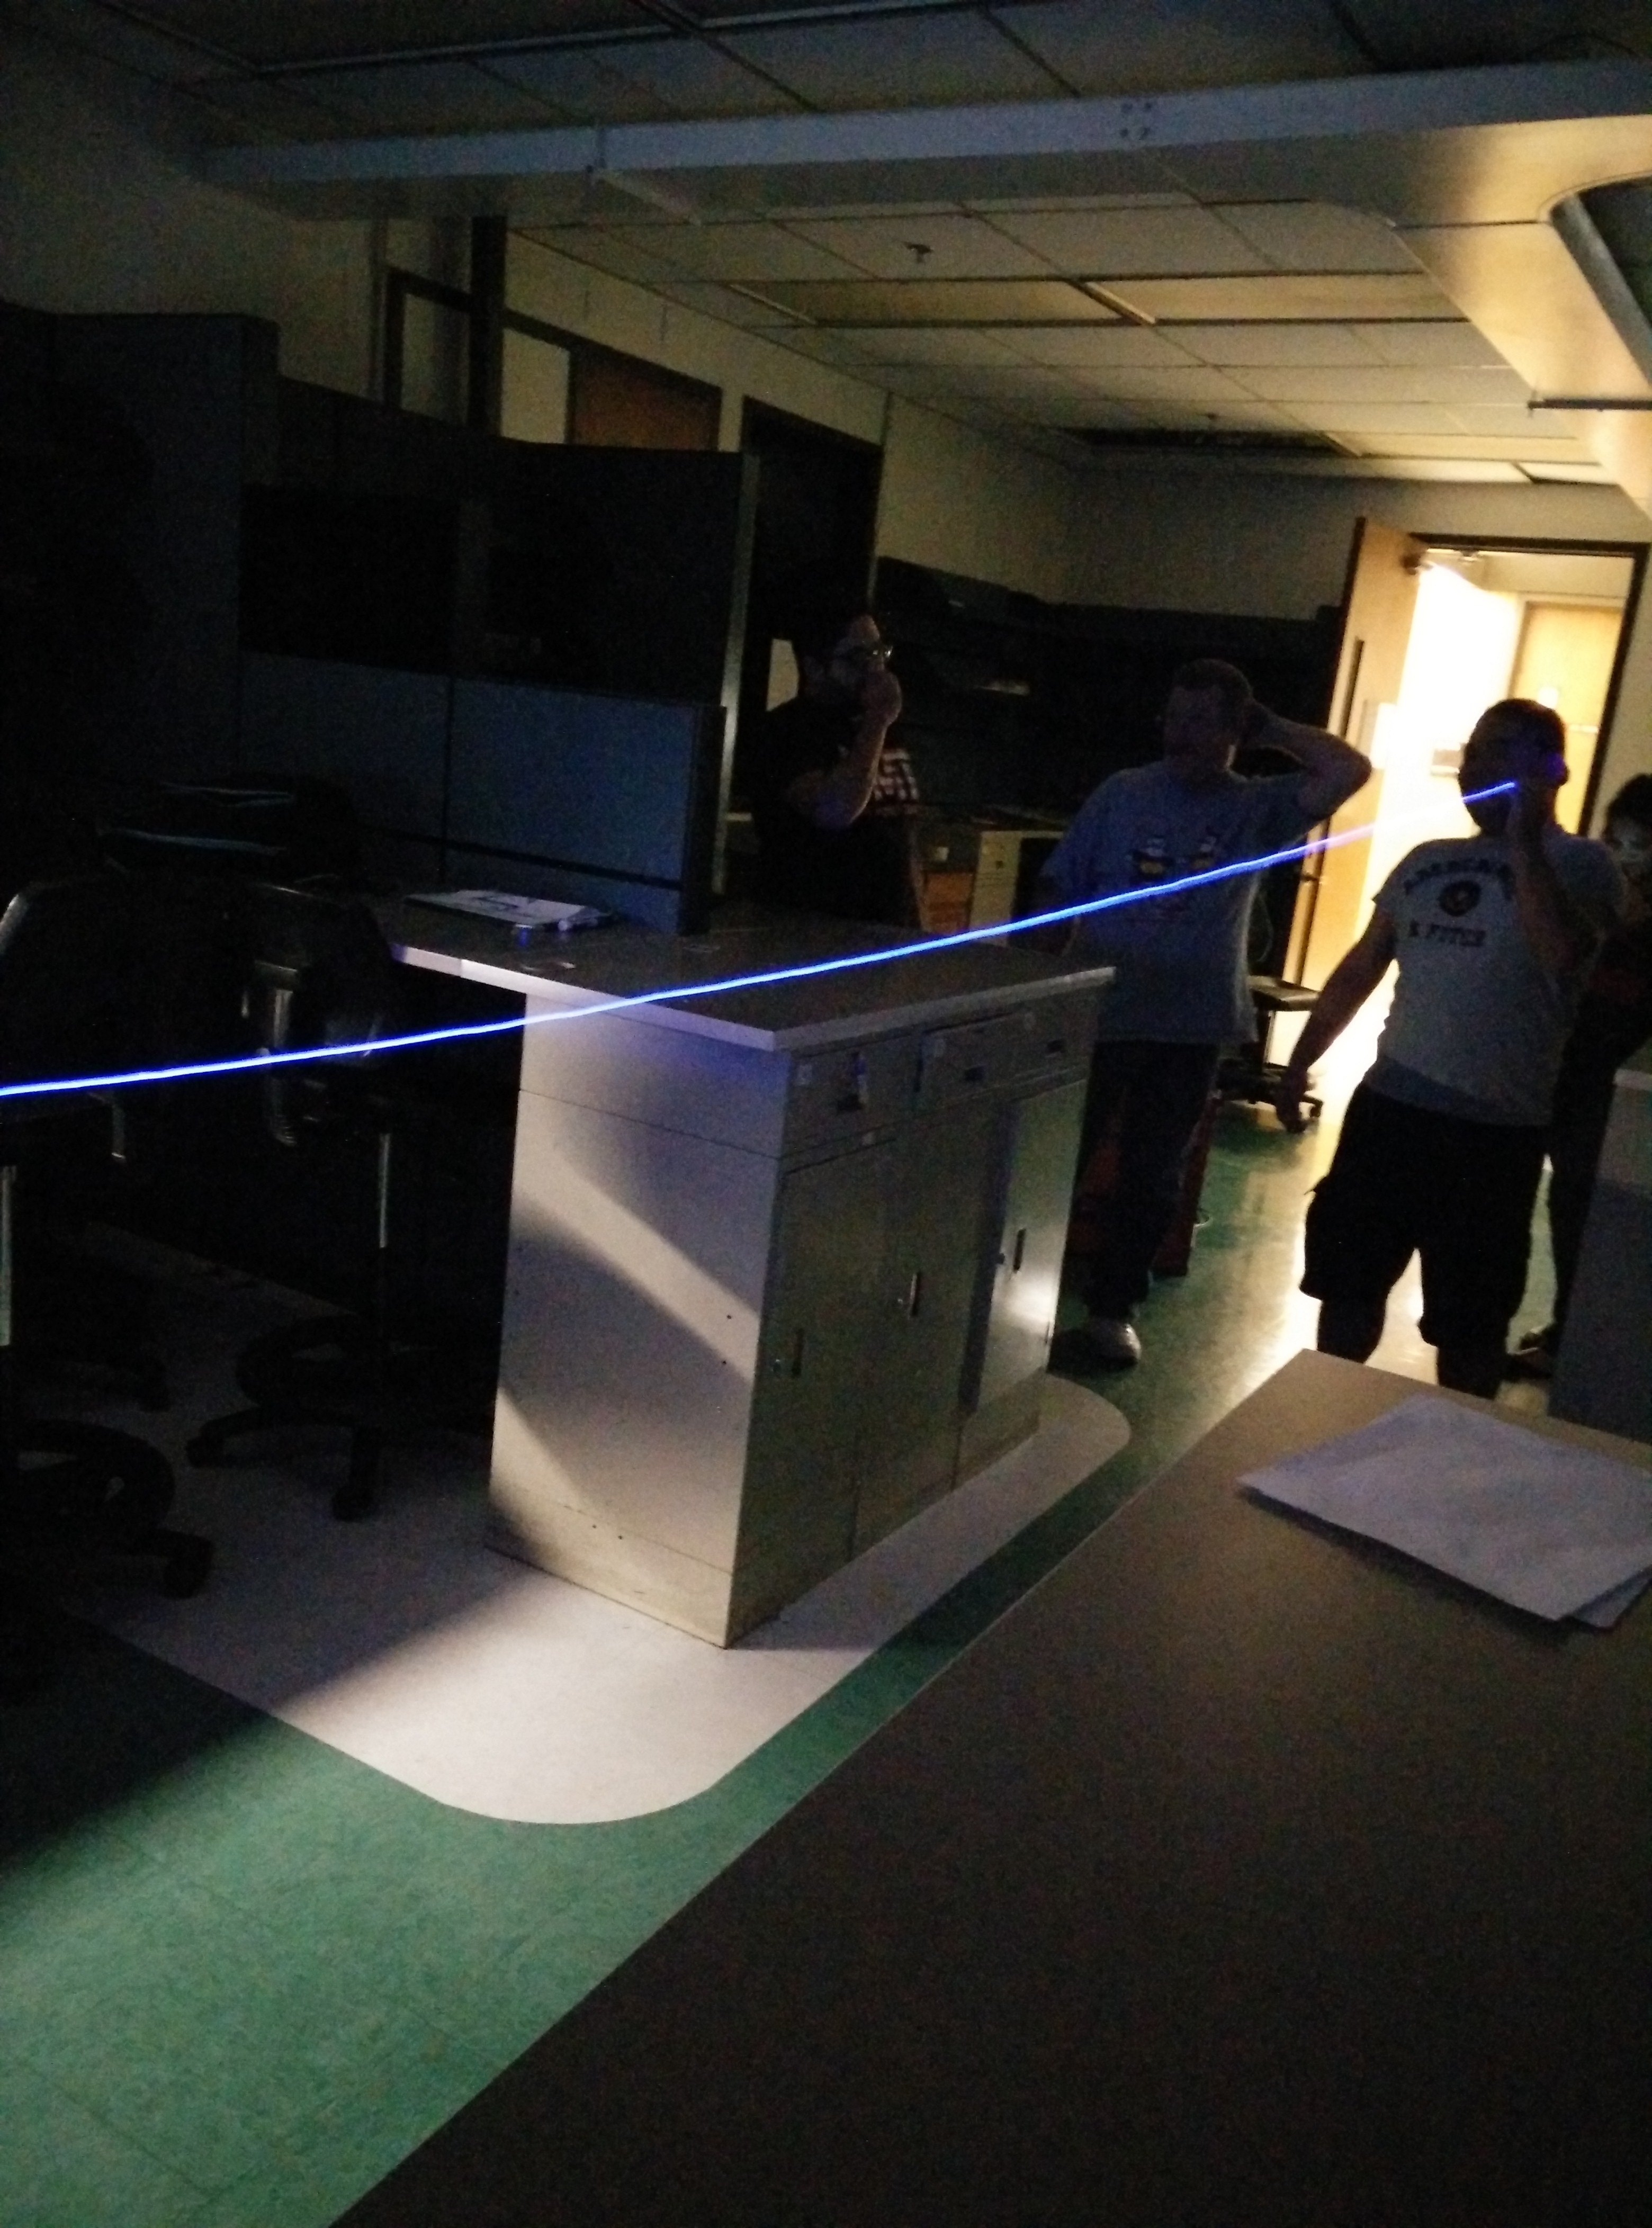
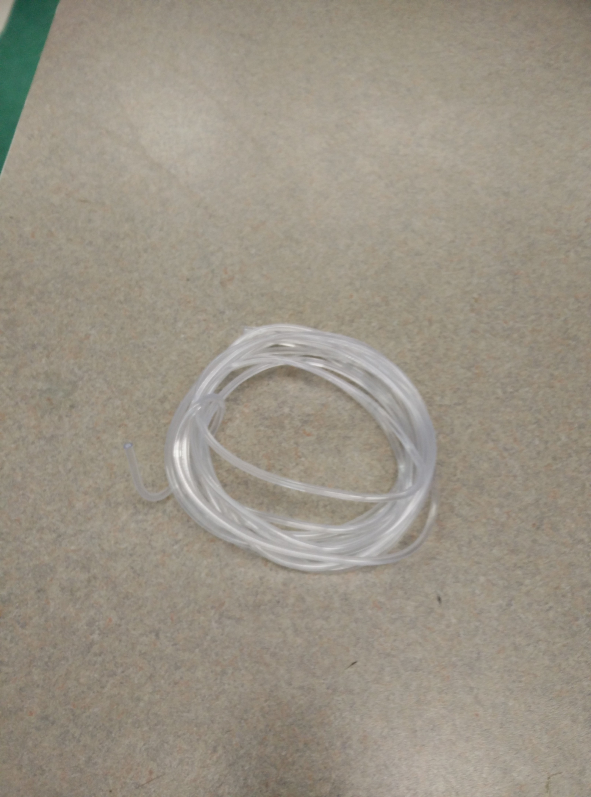
Fiber Plastic
Transition visible light
Nice surface and transparent
Long life-time

Slide 15
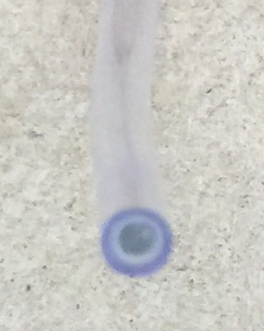
Fiber Plastic
Excellent toughness and can bend random
Excellent fiber diameter uniform distribution

Slide 16
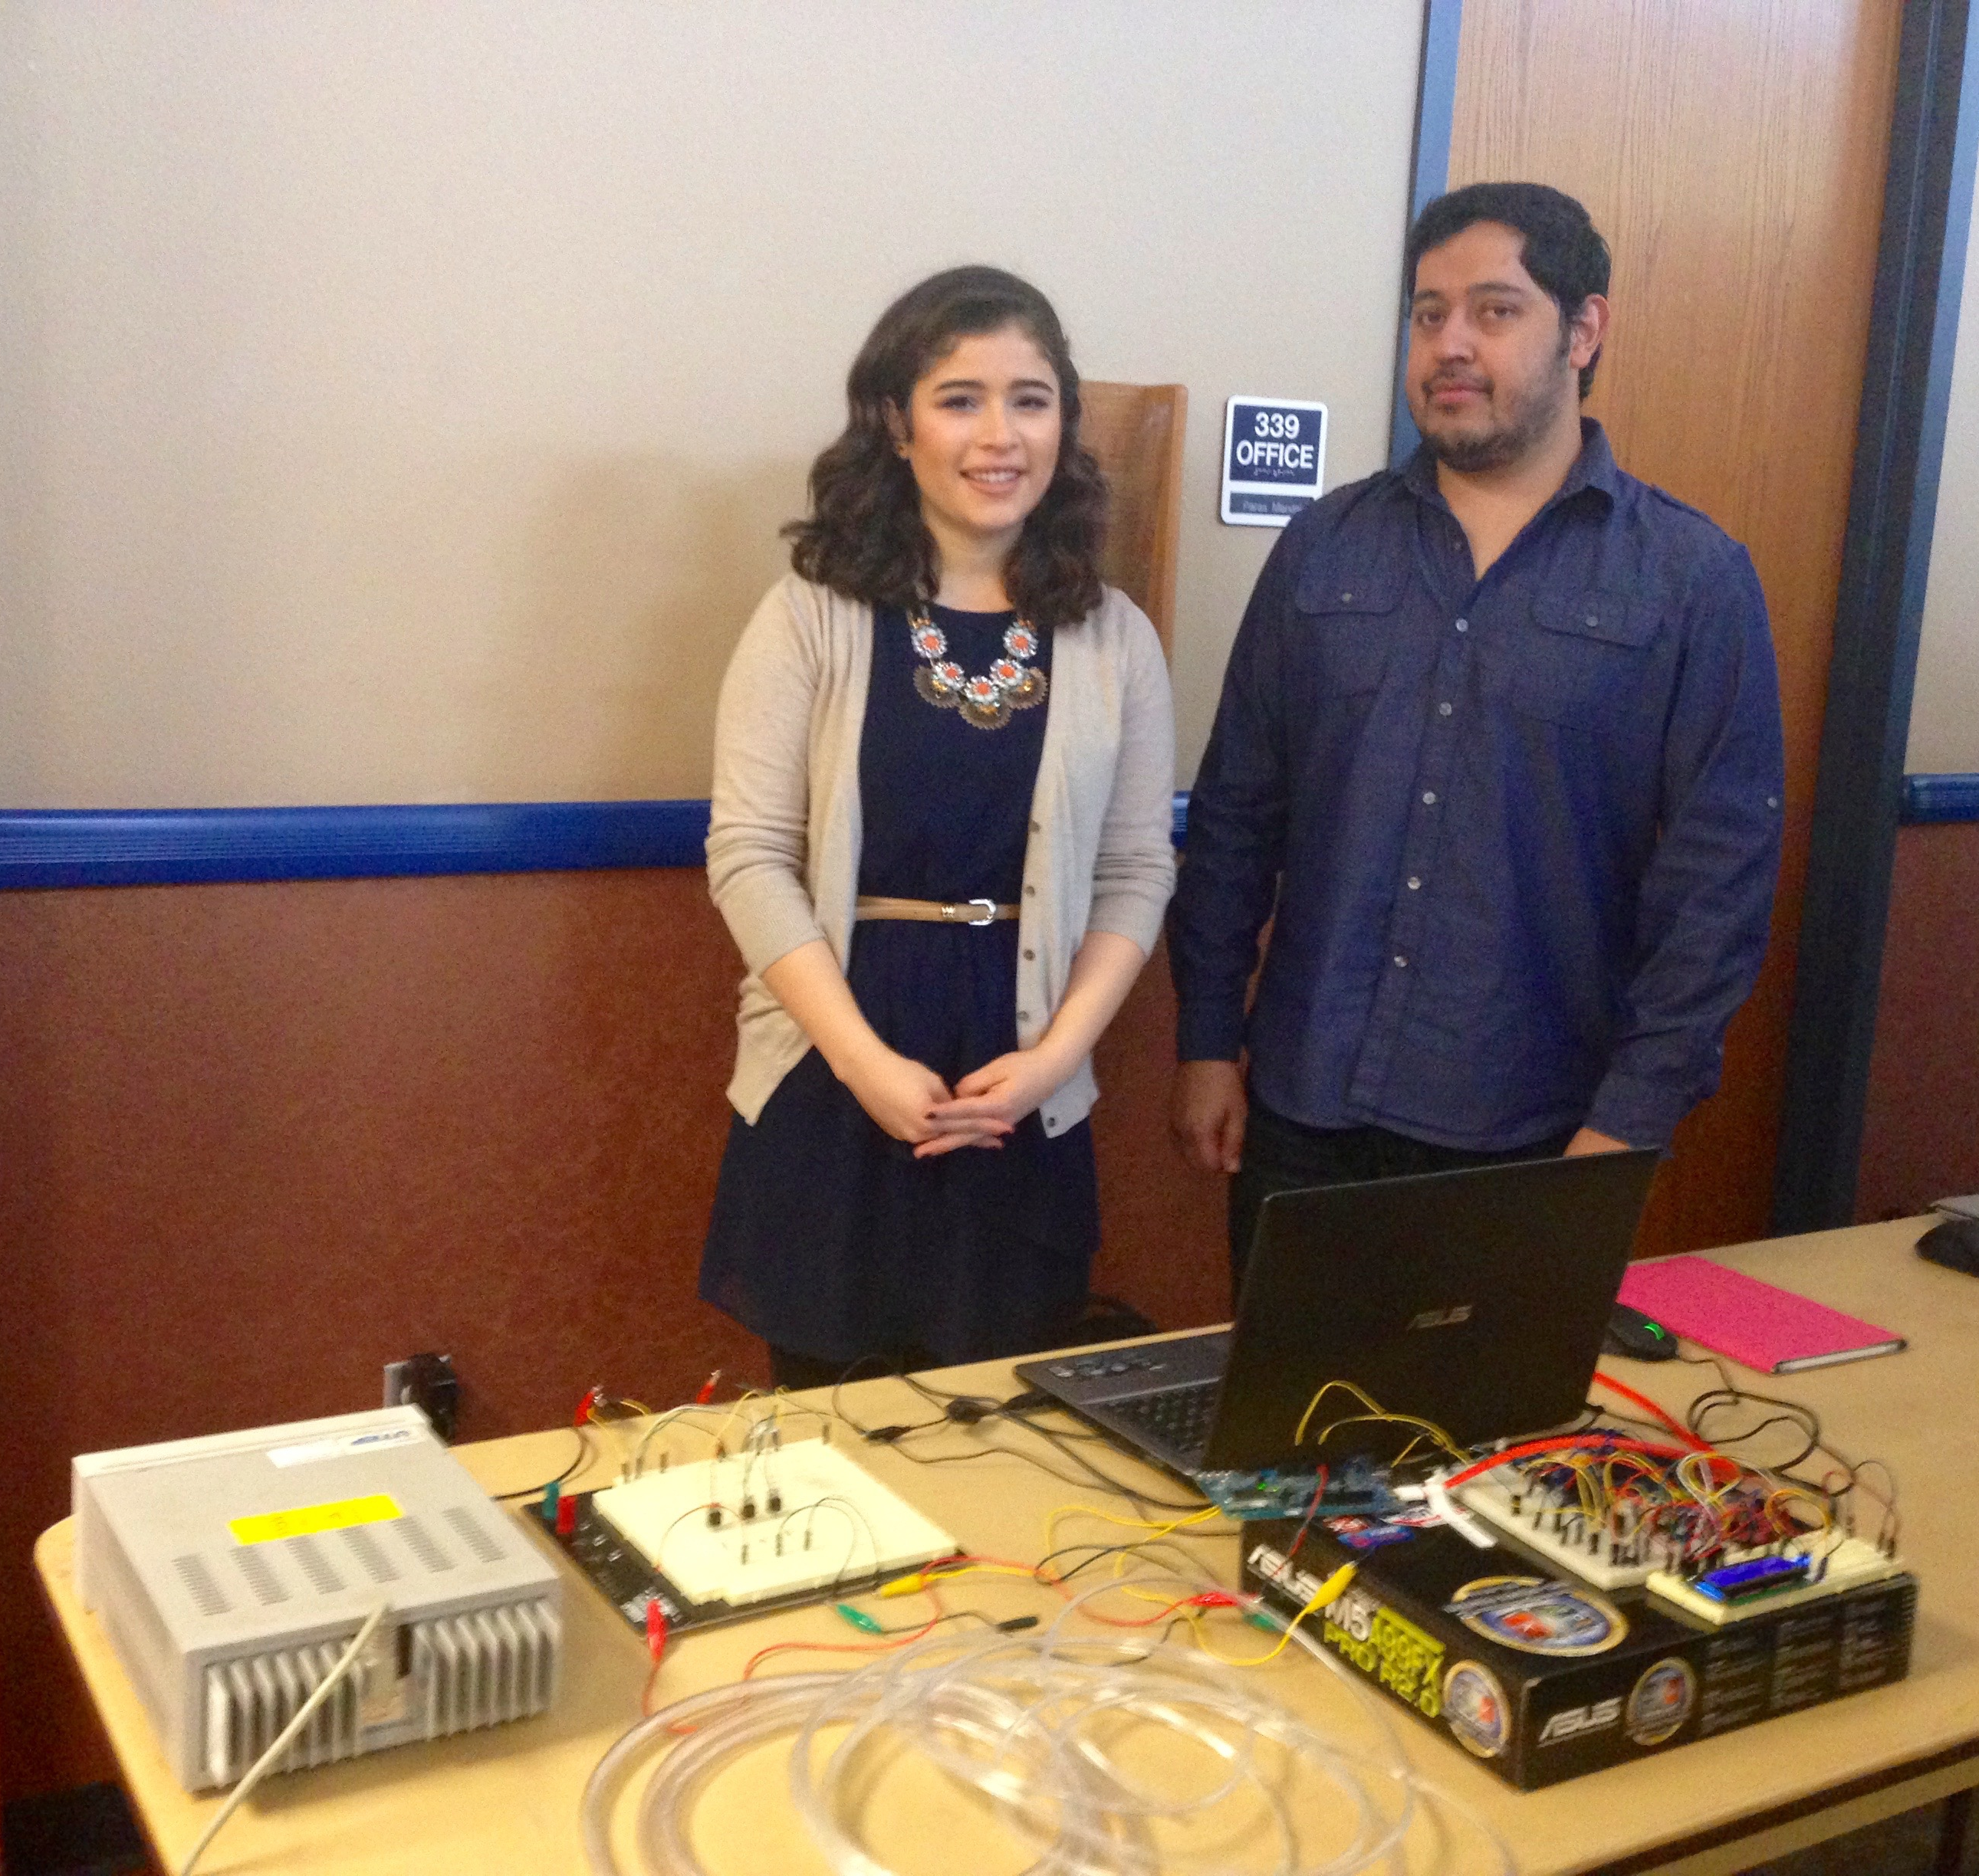
Questions?

